Slide 1

Experience Sharing on Implementing of Energy Efficiency Standard for Household Air Conditioners in China and other countries
Prepared by Colin Du , International Copper Association (China)
Hanoi City , Vietnam , August 21,2012

Slide 2

Content
1. History of Energy Standards Development for HHAC In China
2. Current Test Methodology of for HHAC in China and World
3. Suggestion on Energy Efficiency Standard Update in Vietnam

Slide 3
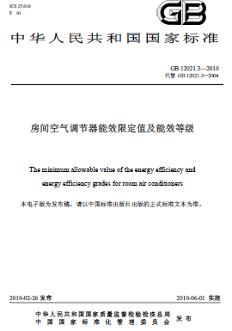
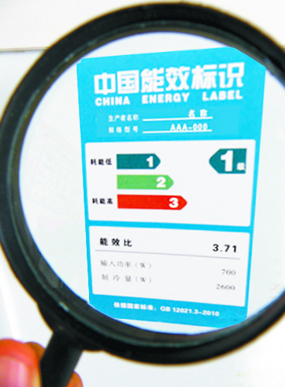
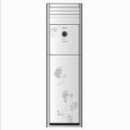
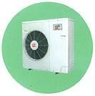
1.History of Energy Standards Development for HHAC In China

Slide 4
Why ES&L in China?
Household appliances consume increasingly large shares of China’s total electricity, while other commercial and industrial products consume significant electricity
Share of China Total Electricity Consumption, 2009
Source: CNIS 2010 White Paper
Notes:
Find pictures?

Slide 5
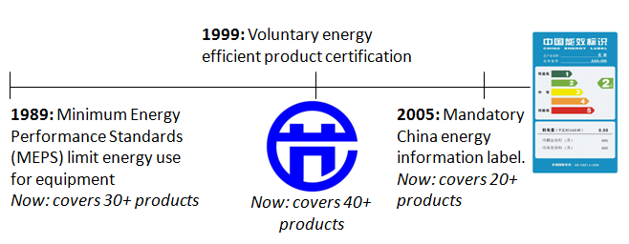
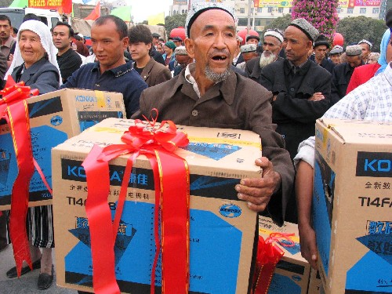
China’s Appliance Efficiency Programs
Regulatory Standards & Labeling (S&L) Programs:
Financial Incentives:
manufacturer subsidy program for efficient lighting
2009-2010 rebate for efficient (Grade 1 & 2) air conditioners

Slide 6
Development Course of Energy Efficiency Standard Making for HH AC in China
Non -inverter
Non -inverter
Non –inverter
99%
99%
76%
1989: Minimum power consumption starndard
2004: MEPS & Set up 5 grades labeling
2010: Renewed MEPS& set up 3 grades labeling
1989
2004
2008
2000
2010
2013*
Non -inverter
Inverter
Inverter
99%
8%
50%
2008: 1st MEPS of SEER & set up 5 grades labeling (Inverter A/C)
2013?*:Revised MEPS and SEER and add APF & 3 grades labeling
2000: 1st MEP of EER(mandatory )

Slide 7
Key Elements of Determining the Establishment of ES&L for HH AC in China
Key Elements of Decision Making for Establish ES&L standards
The Energy Conservation law of China(1998)
Improve public awareness to build a national Energy saving society
Fully consider purchasing power of consumer s and acceptance to EE product s
Evaluate current product portfolio and ration of current EE levels of HH A/C
Evaluate technical level of whole industry and laboratory capability to meet mandatory regulation

Slide 8
Total Production of HH AC in China

Slide 9
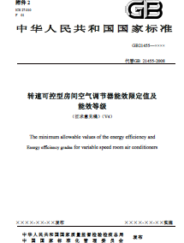
Implementing Both EER and SEER standards based on Product Portfolio in China
EER & 3 Grades for labeling, Mandatory
SEER & 5 Grades for labeling, Mandatory

Slide 10
Minimum Energy Efficiency Values for HH AC in China
Type | Rated cooling capacity | 2000 EER |  | 2004 EER | 2009 EER | 2008 SEER | 2011 SEER | 2010 EER
 |  | Cooling air | Heat pump | Cooling air /Heat pump
Packaged | CC≤4500 | 2.20 | 2.15 | 2.30 | 2.90 |  |  | 2.90
 | CC＞4500 | / | /
Split | CC≤2500 | 2.50 | 2.40 | 2.60 | 3.20 | 3.00 | 3.90 | 3.20
 | 2500＜CC≤4500 | 2.45 | 2.35
 | 4500＜CC≤7100 | 2.40 | 2.30 | 2.50 | 3.10 | 2.90 | 3.60 | 3.10
 | 7100＜CC≤14000 | 2.30 | 2.25 | 2.40 | 3.00 | 2.80 | 3.30 | 3.00
Note: EER for room AC, W/W, SEER for variable speed room AC, W.H/(W.H)

Slide 11
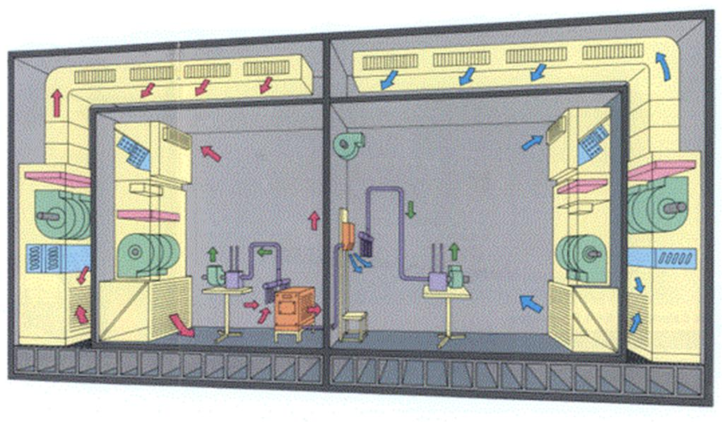
2.Test methodology and Potential Challenges of Implement APF for HH AC
Outdoor side
Indoor side

Slide 12
Difference between Current Test standards and Practical Operation in China
Practical Operation
Current Standard
  GB12021.3-2010
  GB21455-2008
Operates mainly at partial load for Inverter A/C
Operates at both cooling and heating modes
Operates at non-rated conditions
EER-- full load point
SEER --full load + half load

Slide 13
Improve Test methodology to Obtain Accuracy Results for Inverter A/C
APF
SEER
SEER -- partial load /cooling mode at different temperature
APF--- take into account of both heating and cooling mode at different temperature as well as partial load

Slide 14
International Test standards for H A/C performance assessment
Country | Standard | Performance assessment
China | GB/T7725 GB12021.3 GB21455 | EER/SEER
America Korea | 10 CFR 430.23(a)&(b) 10 CFR 430BAppA1&B1 KS C 9306 | EER
EU | BS EN14511-1~4 EN 14825 | SEER/EER、SCOP/COP
Japan | JIS B8615-1~2 JIS C9612 JIS B8616 | APF
AS/NZS | AS/NZS3828.1~3 | EER,COP

Slide 15
Comparison of ISO 5151:94 & ISO5151:10
S/N | Item | ISO5151:2010 | ISO 5151:1994
1 | Data collection period and interval | Data collection period over 35min,intervals span 1 min or less | Data collection period 35min, intervals span 5 min
2 | Transient test | Air enthalpy test method Balanced-type calorimeter test method | Air enthalpy test method
3 | Minimum heating test | Run 1h after equilibrium conditions | Run 4h after equilibrium conditions
4 | Cpa at inlet & outlet | Different value | Same value
5 | Nozzle flow rate coefficient | Formula expression | figure

Slide 16
Test Comparison for Inverter and Non Inverter A/C
Conditions |  | EER | COP | SEER | APF
Cooling | Rated | √ |  | √ | √
 | Partial load |  |  | √ | √
Heating | H1 |  | √ |  | √
 | Partial load |  |  |  | √
Note: H1-inlet wet bulb temperature=6°C, inlet dry bulb temperature=7°C
rated condition=standard condition

Slide 17
Comparison of Testing Load for Calculating SEER& APF between EU and China
Conditions | Cooling mode | Heating mode
China, Japan | 25%, 5%, full load | 25%, 50%, full load
EU | 21%,47%,74%,full load
 | High temperature | Average temperature | Low temperature | Outdoor dry/wet bulb temperature | Indoor dry bulb temperature
A | N/A | 88% | 61% | -7 / -8 | 20
B | 100% | 54% | 37% | 2 / 1 | 20
C | 64% | 35% | 24% | 7 / 6 | 20
D | 29% | 15% | 11% | 12 / 11 | 20
E | Maximum speed | Maximum speed | Maximum speed | Minimum outdoor temperature | 20
F | Speed under minimum outdoor temperature according to building load |  |  |  | 20

Slide 18
Challenges of implementing APF in Future in China
Update hardware & software of current labs
Determine of beginning and ending of defrost cycle
Increase test period and cost
Challenges of compliance of test results from various labs

Slide 19
Need Investment to Update Laboratory Facility
APF includes a low temperature & low load test. In order to guarantee measurement accuracy, the dry & wet bulb temperature measurement is particularly important. Hence, need update dry & wet bulb temperature meter and the data acquisition instrument of class Ⅱ which need more investment
Update dry & wet bulb temperature meter and the data acquisition instrument of class Ⅱ
点击添加文本
点击添加文本

Slide 20
Increase Test Period and Manpower Input
EER |  | Full load | 1.5h
COP |  | Full load | 1.5h
SEER | China, Japan | 25%¹⁾,50%,100% | 4.5h
 | EU | 21%,47%,74%,100% | 6.0h
SCOP | EU |  | Minimum 2days
APF | China, Japan | 25%¹⁾,50%,100% | 4.5h
 | EU |  | Minimum 2days
Increase Test Period and Manpower Input
Note: 1) Do this test when cooling capacity more than 7100W, otherwise, such test is not needed.

Slide 21

Increase The Cost to Update Software and Training for Staff
The software of current lab must update for APF calculation and also strength training
点击添加文本

Slide 22
How to determine the beginning and ending of defrost cycle in the software is another challenge
There exist difference in term of determine the time point at different laboratories and software supplies
点击添加文本
text2
The Beginning time of defrost cycle
text2
The Ending time of defrost cycle

Slide 23
APF: Average Performance Factor
APF: The ratio of heating & cooling capacity and total power consumption in a year
GB 7725-2004
HSTL：Total heating capacity during heating season
HSTE：Total power consumption during heating season
CSTL： Total cooling capacity during cooling season
CSTE：Total power consumption during cooling season
Temperature of the heating season requires heating operation of the outdoor environment occurred | Total : 433 Hours
Temperature of the C0oolingseason requires heating operation of the outdoor environment occurred | Total : 1136 Hours

Slide 24
Calculation for Test Results By APF
Cooling mode
Test results under standard condition at different load speed
Low temperature cooling at different load speed
CSTE
SEER
Rated maximum heating capacity
HSTE
Rated minimum heating capacity
HSPF
Heating mode
Test results under standard condition at different load speed
SCOP, SEER, APF

Slide 25

Challenges of Accordance of Test Results
1
Instrument accuracy, test method especially charging refrigerant, software calculation etc.
2
How to determine the beginning and ending of defrost cycle is a key fact to influence the accordance of test results.
3
Testing stability under low load.

Slide 26
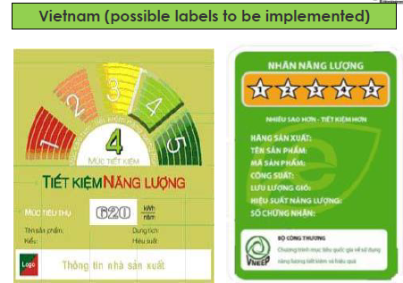

3.Suggestion on energy efficiency standard update in Vietnam

Slide 27
Minimum energy efficiency in Vietnam and China
Type | Cooling capacity, φ W (BTU/h) | Minimum energy efficiency, W/W
 |  | Vietnam |  | China
 |  | 2007 | 2012 | EER | SEER
Single | − | 2,30 | 2,60 | - | 2.9
Split | φ < 4 500 (φ < 15 000) | 2,60 | 3,00 | 3.90 | 3.2
 | 4 500 ≤ φ < 7 000 (15 000 ≤ φ < 24 000) | 2,50 | 2,80 | 3.60 | 3.1
 | 7 000 ≤ φ < 14 000 (24 000 ≤ φ < 48 000) | 2,40 | 2,60 | 3.30 | 3.0

Slide 28
Practical operation of room AC in Vietnam
Climate in Vietnam
Vietnam located south of tropic of Cancer with average annual temperature more than 22 ℃.
Practical situation of room AC in Vietnam
Most of the room air conditioners in Vietnam are working at cooling mode.
Most room air conditioners in Vietnam market are low efficiency products
Current standard in Vietnam doesn’t take standby mode energy consumption into account.

Slide 29
Comprehensive Consideration of the interests of Stake holders in the market
Market Status in Vietnam
Total Consumption of HH A/C: 630,000 units (Y2011)
More than 90% is Non inverter A/C, 10% is Inverter A/C
Low efficiency products has the largest market shares
Purchase power for High EE A/C is weak
Supply Chain in Vietnam
Imported A/C dominated the market
Distribution of EE levels on sale in the market is uncertain
Capability of laboratories
Investment on hardware and software
Capability Building for the Staff at Labs
Compliance with third part labs

Slide 30

Suggestion on energy efficiency standard update in Vietnam
Improve standard requirement of energy efficiency value.
Take standby mode into account
Adopt different test method standard energy efficiency value standard for HHAC and variable speed HHAC
It is recommended to refer to ISO 5151:2010 to draw up the test method standard
Use different energy efficiency assessment parameter is more practical
EER --only cooling HHAC
SEER--cooling and heating HH AC

Slide 31
Thank You
Contact Information
Colin Du
Project Manager for Energy Efficient Heat Exchange - China & South East Asia
International Copper Association Ltd., China
Shanghai Representative Office
Rm. 2814-2824, 28/F, Shanghai Central Plaza, 381 Huai Hai Zhong Road, Shanghai, 200020, China
Phone (86) 21 6391 5816-508
Mobile (86) 13601719226 Fax (86) 21 6391 6331
E-mail colin.du@copperalliance.asia www.copperalliance.org

