Slide 1
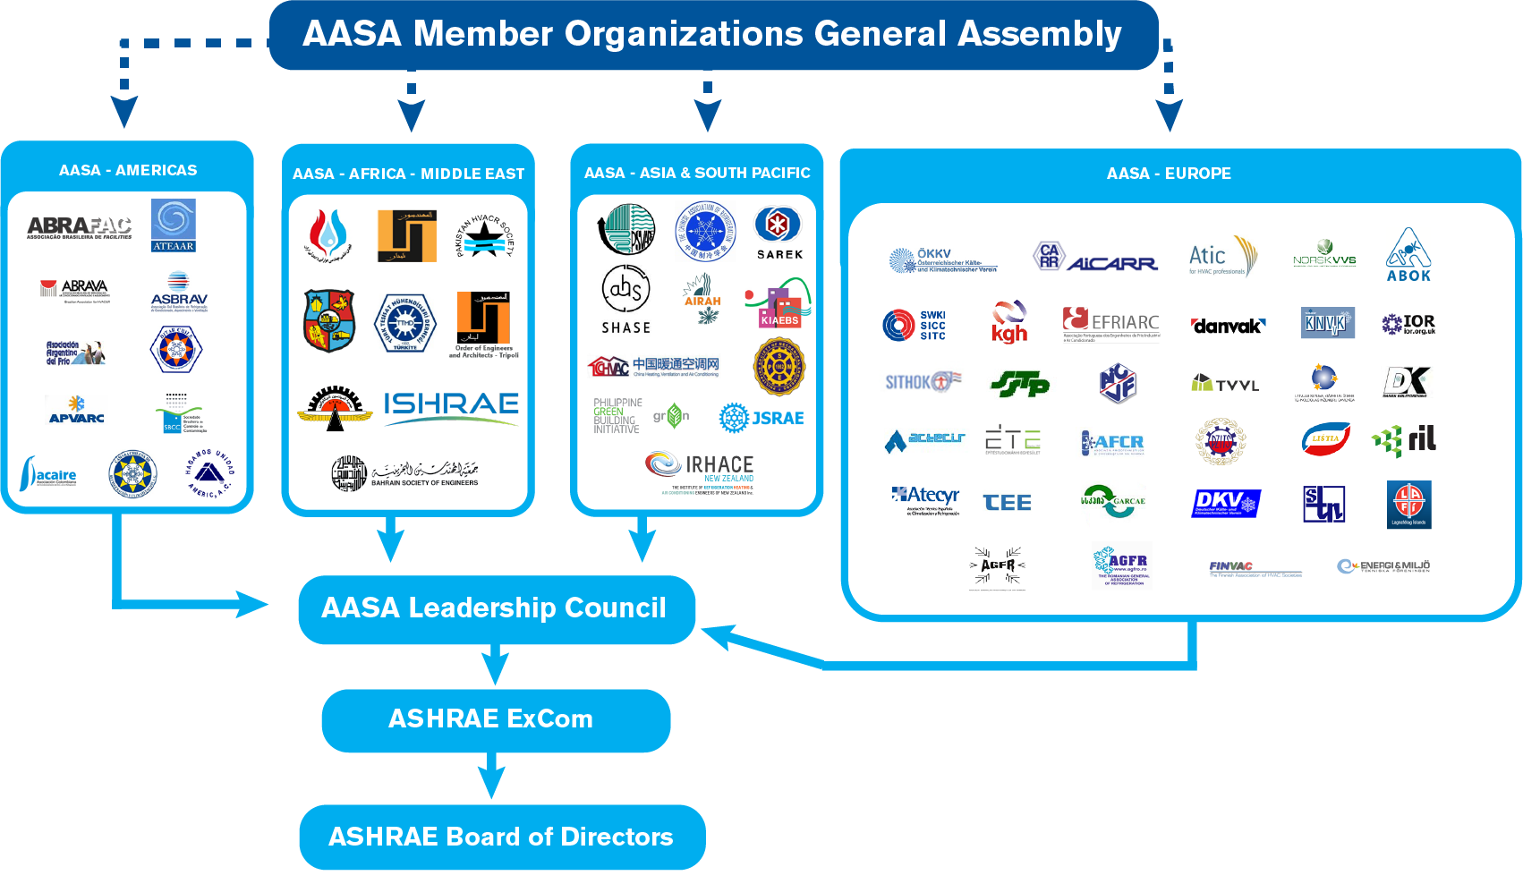
AASA Proposed Structure

Slide 2
AASA Proposed Structure

